Slide 1
SOLUTION TO ENERGY CRISIS OR SCARCITY

Slide 2
Owing to the growing importance of energy awareness, efforts should be systematically diverted in the following directions to tackle the gigantic energy crunch problems:
Minimizing population growth exploitation and harnessing the large utilization of known and unknown energy reservoirs.
Development of energy conversion techniques to convert basic energy available from energy reservoirs (primary energy resources) to usable form of energy (secondary energy resources).
Usable energy form should be such that it is easy to generate, control, transport, and utilize. Electrical energy being the one and only usable form of energy to meet all these at present.
Hydrogen energy and heat energy are other usable energy forms that are also being projected.
Keep the new energy system pollution free as far as possible, thereby environmentally acceptable to human beings.
The development of cheap and reliable energy storage systems. Maintaining new energy development program that is independent of foreign impact to the extent is possible.
Energy management.

Slide 3
FACTORS AFFECTING ENERGY RESOURCE DEVELOPMENT
Energy or Fuel Substitution or Scale of Shift
Energy Density
Power Density
Intermittency
Geographical Energy Distribution

Slide 4
ENERGY RESOURCES AND CLASSIFICATION
Primary and Secondary Energy Resources
Primary energy resources are derived directly from natural reserve. Examples are chemical fuels, solar, wind, geothermal, nuclear hydropower, etc.
They are used either in basic raw energy form or by converting them to usable form (secondary energy).
Secondary energy resources are usable forms of energy generated by means of suitable plants to convert the primary energy.
Examples are electrical energy, steam power, hot water power, hydrogen energy, etc.

Slide 5
Primary energy resources may be further sub-classified as follows:
Conventional energy resources: They are the energy stored within the earth and the sea. They include both fossil fuels (coal, oil, and gas) and nuclear energy (uranium and thorium) and required human intervention to release the energy from them. These sources have formed over hundreds of millions of years ago and when they are used, there will be no more for future generations. They are also known as finite energy resources.
Non-conventional energy resources: They are also known as infinite energy resources.
Renewable energy resources: These are continuously restored by nature. Examples are solar, water, wind, etc.
Non-renewable energy resources: resources are the reserve that is once accumulated in nature has practically ceased to form under new geological conditions. They are also known as expendable energy. Examples are coal, oil, gas, nuclear, etc.

Slide 6
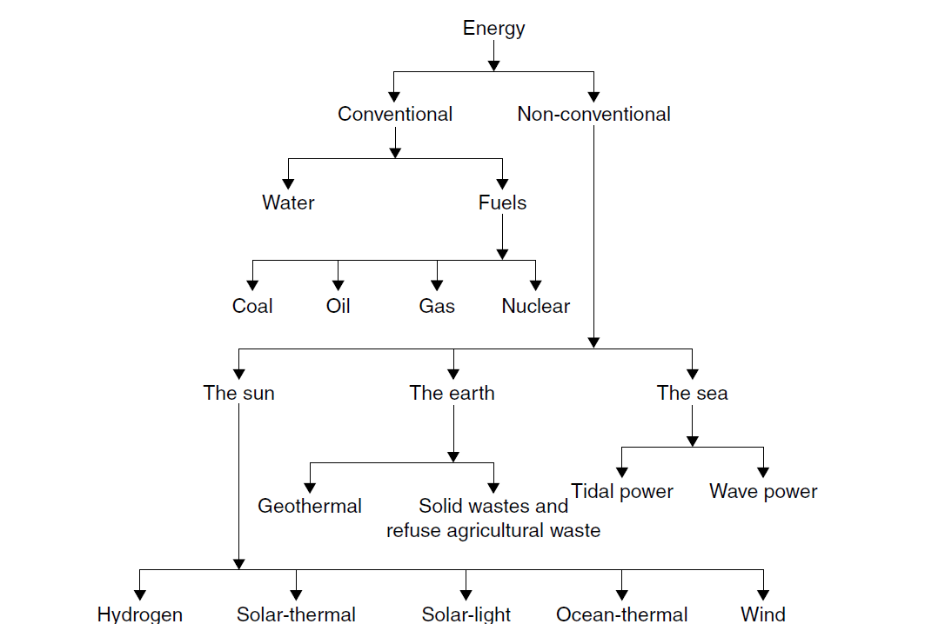
Classification of Energy Resources

Slide 7
Fuel energy resources
Oil
Coal
Natural Gas
Uranium

Slide 8
RENEWABLE ENERGY
Renewable energy is the energy that comes from natural resources such as sunlight, wind, rain, tides, and geothermal heat, which are renewable (naturally replenished).

Slide 9
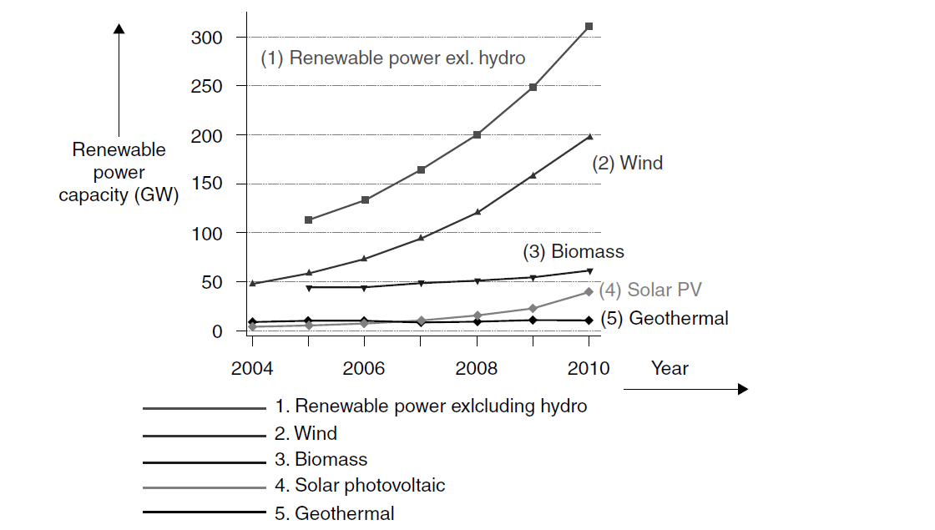
Worldwide Renewable Energy Availability

Slide 10
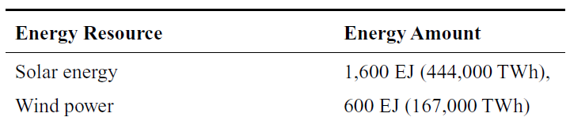
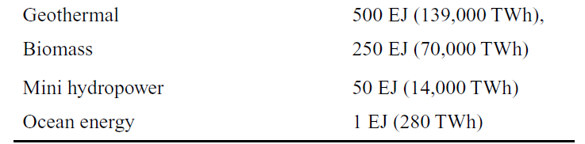
Potential for worldwide Renewable Energy

Slide 11
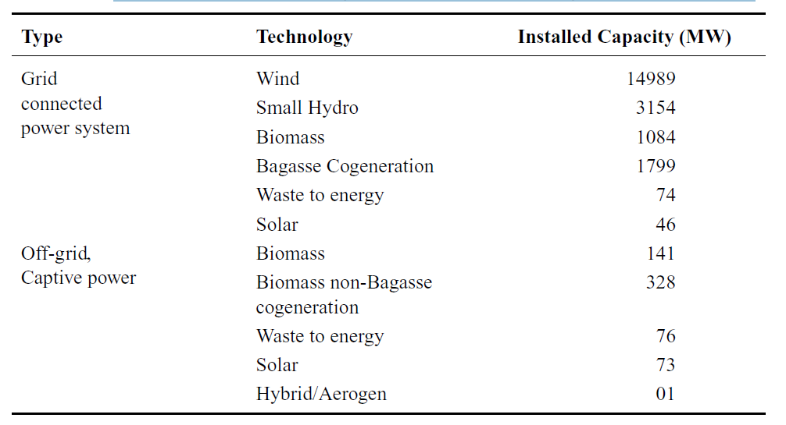
Renewable Energy in India
India Installed Capacity of Renewable Energy Till August 2011

Slide 12
Renewable Energy in India
Solar Energy
Wind Power
Tidal Power
Wave Energy
Ocean Thermal Energy
Biomass Energy
Decentralized and dispersed Generation
Geo-Thermal Energy

Slide 13
Solar Energy
The annual amount of energy received from Sun as Heat & Light is about a Billion KWH.
With a proper combination of different types of materials, we can convert this Heat and Light energy using Solar Thermal Panels & Photovoltaic cells as Heat energy & Electricity.
The conversion rate is only about 10%.
Solar heating and photovoltaic are potentially a very large source of energy in the forms, and the technology to use them already exists.
Still, it has to be worked out how to integrate them with other technologies, and they need storage to be used effectively.

Slide 14
Solar Energy
The energy extracted from the sun as solar radiation by means of solar thermal panels and photovoltaic cells could convert this to any desired combination of heat and electricity is called as solar Energy.
Solar photovoltaic cells convert sunlight into electricity and photovoltaic production has been increasing by an average of more than 20% each year since 2002, making it a fast-growing energy technology.
Advantages,
the potential amount of energy that could be produced annually is 10˄8 kWh; this would mean covering the entire surface of the globe with solar thermal panels and photovoltaic cells.
Disadvantage
Still, it has to be worked out how to integrate them with other technologies, and they need storage to be used effectively.

Slide 15
Wind Power
Wind energy is the kinetic energy of air in motion.
Wind turbines extract the kinetic energy present in the wind, and convert it to rotary shaft motion.
The shaft motion transmits power to generators by gearboxes, belts and pulleys, roller chains, or by hydraulic transmissions.
The power in the wind is proportional to the cube of the wind velocity.

Slide 16
Tidal Power
Tidal plants will probably be worthwhile only in places where the tidal range is particularly large, which means that estimating a ‘world total’ involves not a general assessment but careful site by site investigation.
Tidal power is essentially a specific form of hydropower, and therefore, uses basically the same equipment as a regular tidal station.
The difference is in the available power to extract from the tide.
A reversible hydraulic turbine is used so the inflow and outflow of the tide can generate electricity.
As the tide comes in, the dam allows the seawater to pass through into a holding basin.
As soon as the tide is about to go down, the dam is closed.
The water held back in this way will be used to feed the turbines at low tide.
The ebb and flow of the tides can be used to turn a turbine, or it can be used to push air through a pipe, which then turns a turbine.

